Slide 1
Service Update #24-0110
Holes In Steel Floor Required and Wood is Protected
Holes Through Steel Floor Required For Body Mounting
Recently during DOT inspection of new units with Micro Bird bodies mounted on the Ford chassis, we were asked about 4 holes approximately 2” in diameter (FIGURE #1) located in the floor behind the rear axle. The concern was why the holes were there and if required, was protection of the wood floor above the steel sufficient protection if only undercoating was applied?
Working with Micro Bird engineering, we learned that the holes are pre-punched in the floor panels as the they give access to install and tighten the body mounts and bolts in those locations. (FIGURE #2) Further protection to the floor is provided by a water and vapor resistant butyl membrane which is put over the holes before the wood floor is laid down.
PLEASE NOTE: All information has been supplied to and approved by NYSDOT.

Slide 2
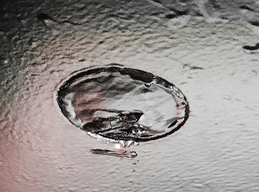
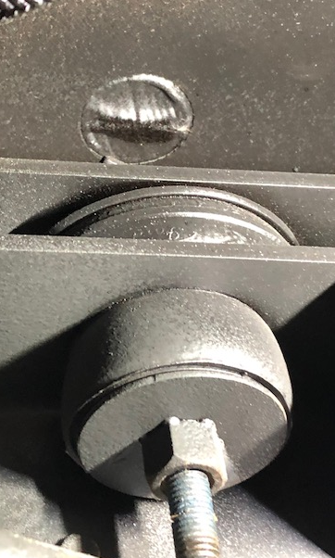
PLEASE NOTE:
As shown in FIGURE #1, you can see the undercoating over the membrane. This area as the rest of the underbody should be check for undercoating coverage during PM inspections and touched up if required.
FIGURE #1
FIGURE #2

Slide 3
CONTACT ANY OF OUR SERVICE LOCATIONS WITH QUESTIONS
Director of Service
Ryan Hemund
rhemund@newyorkbussales.com
Chittenango: 800-962-5768
Brian Lamaitis
blamaitis@newyorkbussales.com
Bob Reith
breith@newyorkbussales.com
Phil Tucker
ptucker@newyorkbussales.com
Albany: 866-867-1100
Ben Reiling
breiling@newyorkbussales.com
Batavia: 800-463-3232
Andrew Faskel
afaskel@newyorkbussales.com
Middletown: 845-609-7070
Moncia Cherry
mcherry@newyorkbussales.com
Comments or Concerns:
John Johnston
jjohnston@newyorkbussales.com
Cell 315-263-0766
Notes:
Set up as a table would make it easier to edit
Add additional pages

