Slide 1


Service Update #24-0226
Missing Fuel Tank Washers
Gasoline Fuel Tank Cage May Be Missing Washers
Recently we were made aware of an issue where certain bolts on the framework of the fuel tank cage may not had flat washers used when assembled.
The bolts in question are for the fuel tank cradle crossmembers where the tank straps are attached. FIGURE #1 shows the bolts properly installed with the washers and FIGURE #2 shows where they were missed during assembly.
The installation diagram of the fuel tank is shown in FIGURE #3 with the bolts, nuts and washers in under the bolt head and under the locknuts highlighted

Slide 2
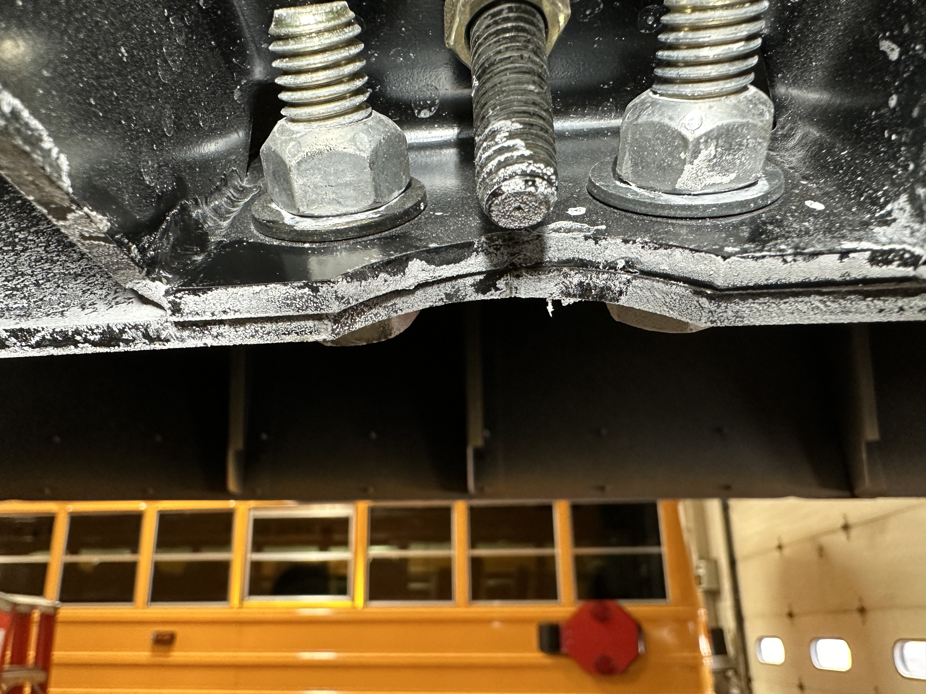
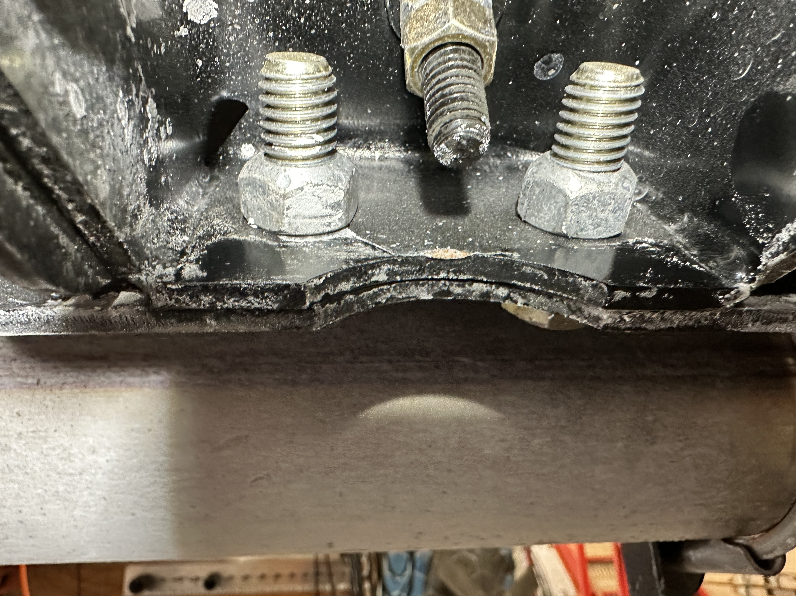
FIGURE #1
FIGURE #2
FIGURE #3

Slide 3
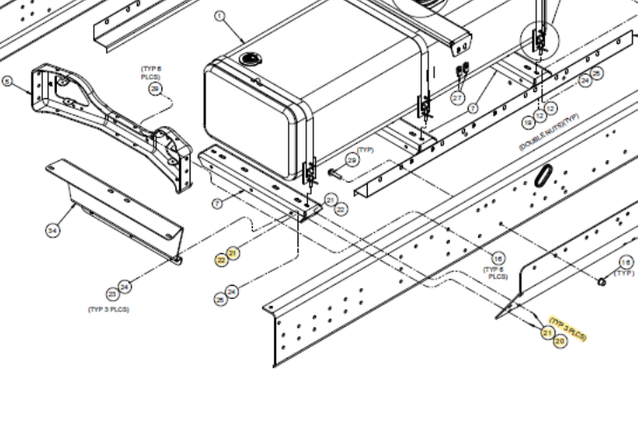
FIGURE #4
A closer look at the diagram in FIGURE #4 shows the bolt assemblies and where they mount the cradle crossmembers to the side plates which are mounted to frame rails along with the specific specifications and Blue Bird part numbers for the individual pieces.
Currently we are only aware of an issue on the BBCV gasoline units.

Slide 4

CONTACT ANY OF OUR SERVICE LOCATIONS WITH QUESTIONS
Director of Service
Ryan Hemund
rhemund@newyorkbussales.com
Chittenango: 800-962-5768
Brian Lamaitis
blamaitis@newyorkbussales.com
Bob Reith
breith@newyorkbussales.com
Phil Tucker
ptucker@newyorkbussales.com
Albany: 866-867-1100
Ben Reiling
breiling@newyorkbussales.com
Batavia: 800-463-3232
Keetah Wallace
kwallace@newyorkbussales.com
Comments or Concerns:
John Johnston
jjohnston@newyorkbussales.com
Cell 315-263-0766
Notes:
Set up as a table would make it easier to edit
Add additional pages

