Slide 1
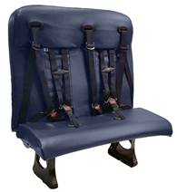
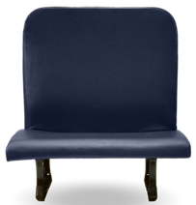
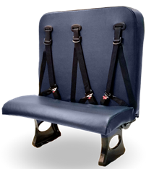
Service Update #24-0302
HSM NextGen Seat H-Tube Plug Retrofit
Blue Bird Bulletin #S23CS
Blue Bird previously released Service Bulletin #S19ZI which was released in conjunction with HSM who manufactured the seats and addressed concern over a passenger(s) inserting their finger into exposed holes in the rear side of the seat back frame. This was addressed by inserting plastic “plugs” into the holes and these plugs were made available by HSM and Blue Bird through New York Bus Sales and sent to customers at no charge upon request. The availability of the plugs were extended as in our Service Update #21-0208 in an effort to inform customers of the need to have these installed, but it was found that some units still did not have plugs installed.

Slide 2
Along with the fact that provided plugs were not installed, further issues were found where the initial style plug could be “pried” out or using a pen or pencil inserted from the hole not plugged on the bottom side of the tube, those plugs could be removed as well as the fact that there was still a hole where a passenger(s) could potentially insert their finger.
HSM found a more secure fitting plug and moved to installing these along with adding them to the holes in the underside of the tubes in production.
In an effort to mitigate further issues with those units in service, HSM initiated the Service Bulletin in the following pages and working with Blue Bird has provided New York Bus Sales with a list of specific units requiring these plugs.
Furthermore, HSM has engaged their own personnel to install these plugs in those units identified and working with New York Bus Salles these Techs will be traveling to customers installing the required plugs.
PLEASE NOTE:
To lessen the impact on customer operations, New York Bus Sales, working from the list provided will be contacting customers who have units requiring plugs to be installed and informing them of an upcoming visit by one of the HSM techs.

Slide 12

CONTACT ANY OF OUR SERVICE LOCATIONS WITH QUESTIONS
Director of Service
Ryan Hemund
rhemund@newyorkbussales.com
Chittenango: 800-962-5768
Brian Lamaitis
blamaitis@newyorkbussales.com
Bob Reith
breith@newyorkbussales.com
Phil Tucker
ptucker@newyorkbussales.com
Albany: 866-867-1100
Ben Reiling
breiling@newyorkbussales.com
Batavia: 800-463-3232
Keetah Wallace
kwallace@newyorkbussales.com
Comments or Concerns:
John Johnston
jjohnston@newyorkbussales.com
Cell 315-263-0766
Notes:
Set up as a table would make it easier to edit
Add additional pages

