Slide 1


Micro Bird G5 GM/Chevrolet Chassis Warranty #22-1222
SALES UPDATE
G-Model 3500 Series vs. 4500 Series
When ordering/purchasing the Micro Bird G5 on a Chevrolet or GM chassis, please be aware that the G3500/12,300lb. and G4500/14,200lb. chassis look very similar……..but looks can be deceiving!
The G3500 is considered a “Light Duty” chassis which is serviceable basically by any Chevrolet or GM automotive dealer. The G4500 series, on the other hand is considered a “Medium Duty” chassis which is NOT serviceable by a Light Duty dealer but needs to go to a Medium Duty dealer for warranty repairs.
There are NOT as many Medium Duty Chevrolet/GM dealers and customers have found that when they attempted to have warranty repairs done at a Light Duty dealer, they were told that the dealer could not submit warranty on a Medium Duty unit.
We have researched and found that the following Chevrolet dealers are advertised as Medium Duty Dealers. We would suggest calling to verify.

Slide 2
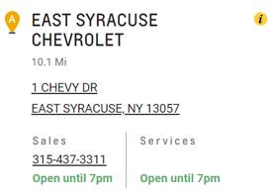
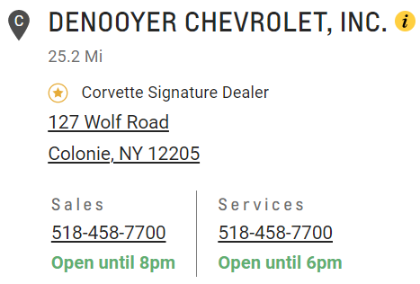
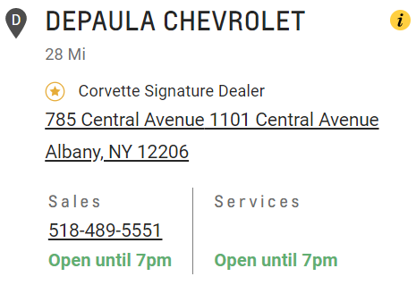
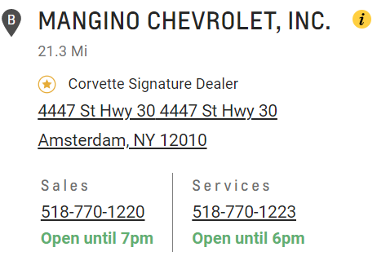
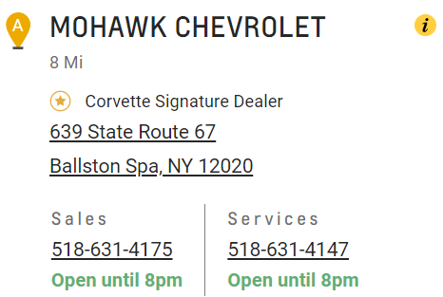
Chevrolet Medium Duty Dealers
Central New York
Capital District

Slide 3
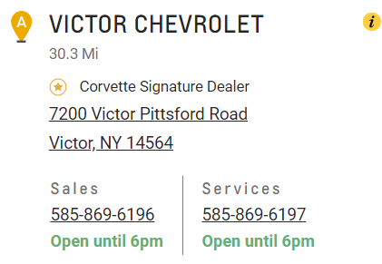
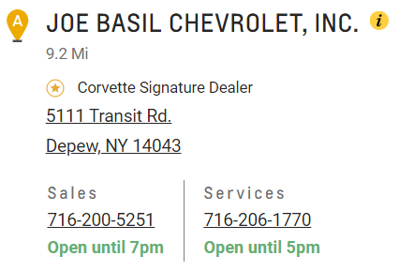
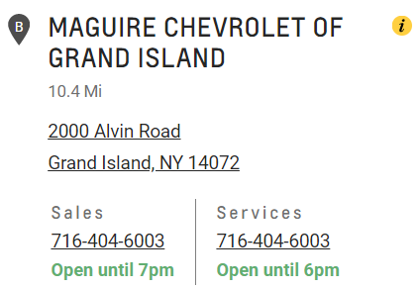

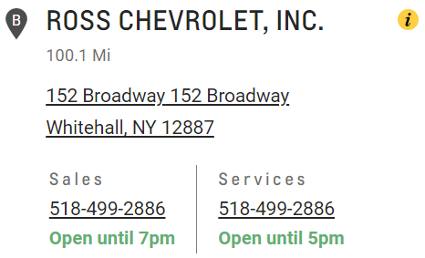
Western New York
Northern

Slide 4
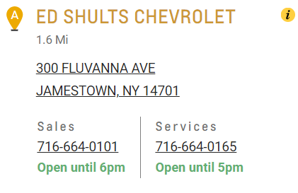

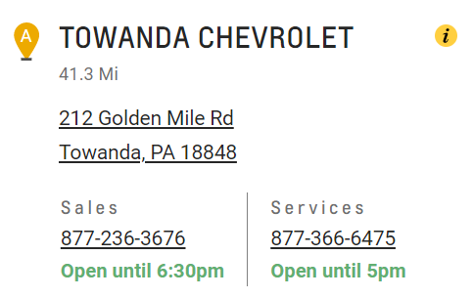
Southern Tier

Slide 5
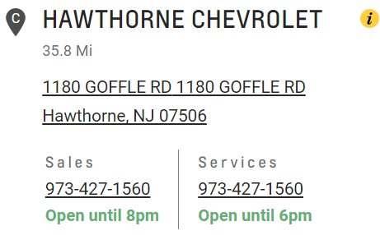
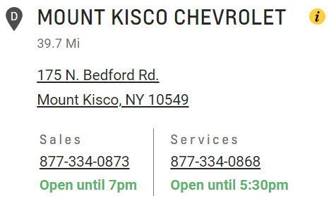
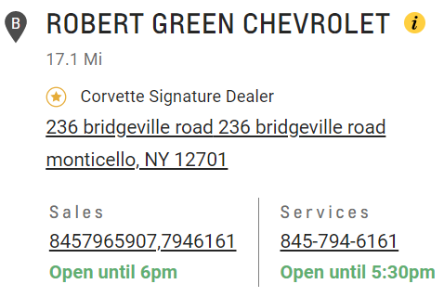

Lower Hudson

Slide 6
CONTACT OUR SALES DEPARTMENT WITH ANY QUESTIONS
Director of Sales
Jeremy Johnston
jjohnston@newyorkbussales.com
315-706-8944
Josh Coon - Central
jcoon@newyorkbussales.com
Cell 315-264-1245
Kevin Coon - North
kcoon@newyorkbussales.com
Cell 315-415-6570
Peggy Allis - West
pallis@newyorkbussales.com
Cell 716-807-9264
Bill Lyons II - East
wlyons2@newyorkbussales.com
Cell 518-275-2816
Bruce Ferre – Rochester/Southern
bferre@newyorkbussales.com
Cell 585-645-3986
Notes:
Set up as a table would make it easier to edit
Add additional pages

