Slide 1
Service Update #22-1129
Proper Starting Procedure for Blue Bird EV
“WAIT TO START” for EV
With the newest generation EV product, Blue Bird recently released a recommended “Starting Procedure” in the form of a “Service Memorandum” (#SM2203) as it had been noted that rapid re-cycling of the ignition switch could damage the System Control Module (SCM). Please see FIGURE #1
Seeing as the product is new to the market and fully understanding the operation there are some inherent characteristics of the system that many drivers would not expect. One such feature is the “Wait to Start” light and fact that the icon for it would be unfamiliar from other vehicles powered by internal combustion engines.
Therefore, after consideration of how we should address communicating these items best especially seeing as we have a number of Demos traveling the roads of New York State and ensuring that those drivers interested in driving an EV unit would have knowledge of the operation we have developed decals which are placed in view of the driver.

Slide 2
Utilizing Service Memorandum #SM2203, we first felt the need to inform drivers of the “Wait to Start” icon and light so we have a small decal (FIGURE #2/PART #453) which we are placing at the right lower corner of the dash near the key switch so that drivers are aware when starting the unit. We have also taken the procedures and made another decal (FIGURE #3/PART #454) which will be place in the center of the dash.
Both these can be seen as installed on a unit in FIGURE #4.
FIGURE #1

Slide 3
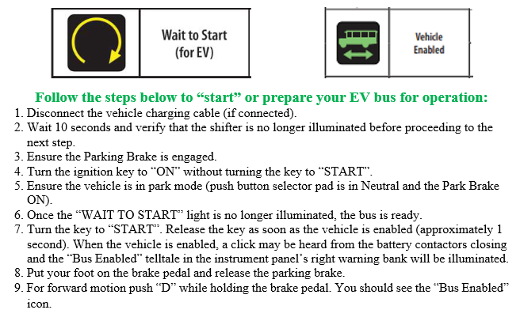
FIGURE #2
FIGURE #3

Slide 4
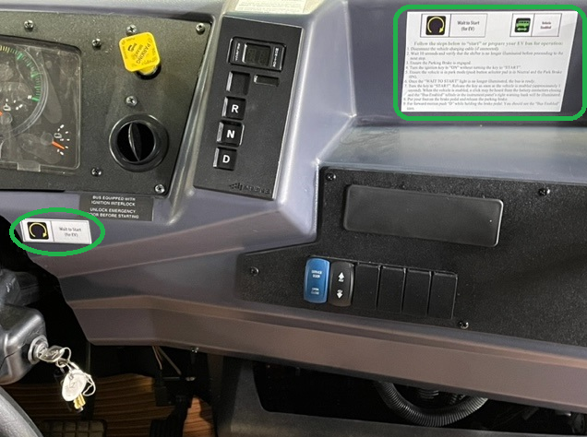
FIGURE #4

Slide 5
CONTACT ANY OF OUR SERVICE LOCATIONS WITH QUESTIONS
Director of Service
Ryan Hemund
rhemund@newyorkbussales.com
Chittenango: 800-962-5768
Daryl Wallace
dwallace@newyorkbussales.com
Brian Lamaitis
blamaitis@newyorkbussales.com
Bob Reith
breith@newyorkbussales.com
Phil Tucker
ptucker@newyorkbussales.com
Albany: 866-867-1100
Ben Reiling
breiling@newyorkbussales.com
Rochester: 800-463-3232
Brandon Shepard
bshepard@newyorkbussales.com
Middletown: 845-609-7070
Moncia Mc Donald
mmcdonald@newyorkbussales.com
Comments or Concerns:
John Johnston
jjohnston@newyorkbussales.com
Cell 315-263-0766
Notes:
Set up as a table would make it easier to edit
Add additional pages

