Slide 1
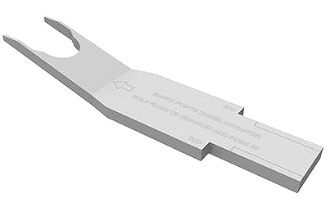
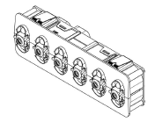
Service Update #23-0303
NEA Switch “Rocker” Removal Tool
SCREWDRIVERS DON’T ALWAYS WORK
With NEA (New Electrical Architecture), which was released on the Blue Bird Vision, the “conventional” switch was replaced with a switch “module”. Using a “Rocker Button”, these modules act as switches to operate the various electric circuits.
Recently we have heard that technicians have had to change the rocker button on the modules and in doing so have broken the attachment tab on the module.
FIGURE #1 shows the back side of a rocker button and if you look close as to where the arrow indicates in FIGURE #2, you will see a plastic tab with a small hole in it. The rocker button “snaps” onto the module with the tabs on the module as shown with green arrow of FIGURE #3 inserted in the holes of those tabs on the rocker.
If using a screwdriver or other flat narrow tool to remove or simply prying up on the rocker, damage to the module can occur as shown by the red arrow in FIGURE #3

Slide 2
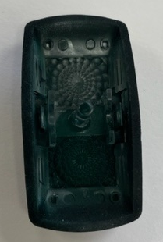
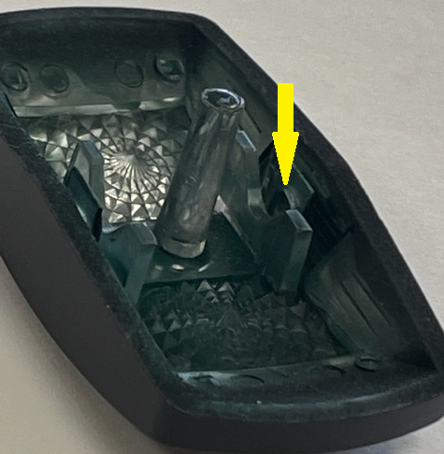
To properly remove the rocker, there is a plastic tool as seen in FIGURE #4 designed to slip in under the rocker and along the sides of the plastic tab of the rocker releasing the round tabs of the module. Instructions are molded into the tool as see in FIGURE #5. This can be done from either the top or bottom of the rocker as seen in FIGURE #6.
PLEASE NOTE:
One tool will be delivered with each new Blue Bird Vision delivered in the paperclip on the dash with our comment card. (FIGURE #7)
You can also purchase through our Parts Department!
Part# 10065314
FIGURE #1
FIGURE #2

Slide 3
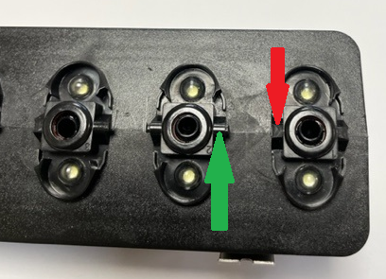
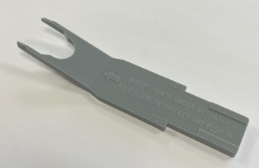
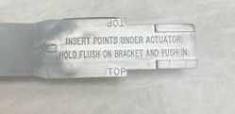
FIGURE #3
FIGURE #4
FIGURE #5

Slide 4
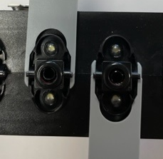
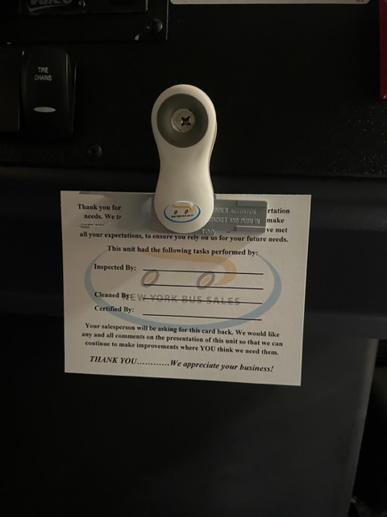
FIGURE #6
FIGURE #7

Slide 5
CONTACT OUR SERVICE OR PARTS DEPARTMENT WITH ANY QUESTIONS
SERVICE
Director of Service
Ryan Hemund
rhemund@newyorkbussales.com
CELL 315-561-9121
Chittenango: 800-962-5768
Daryl Wallace
dwallace@newyorkbussales.com
Brian Lamaitis
blamaitis@newyorkbussales.com
Bob Reith
breith@newyorkbussales.com
Phil Tucker
ptucker@newyorkbussales.com
Albany: 866-867-1100
Ben Reiling
breiling@newyorkbussales.com
Rochester: 800-463-3232
Brandon Shepard
bshepard@newyorkbussales.com
Middletown: 845-609-7070
Moncia Mc Donald
mmcdonald@newyorkbussales.com
PARTS
Director of Parts
Matt ”Woody” Woodman
mwoodman@newyorkbussales.com
CELL 315-271-9748
Chittenango: 800-962-5768
Gari McQuade
gmcquade@newyorkbussales.com
Ted Nerveldine
tneveldine@newyorkbussales.com
John Lewin
jlewin@newyorkbussales.com
Garry Maniacek
gmaniacek@newyorkbussales.com
Jim Mattner
jmattner@#newyorkbussales.com
Albany/Middletown: 866-867-1100
Sean Conway
sconway@newyorkbussales.com
Dan Haight
dhaight@newyorkbussales.com
Rochester: 800-463-3232
James Roeser
jroeser@newyorkbussales.com
Tesea Cornwall
tcornwall@newyorkbussales.com
Comments or Concerns:
John Johnston
jjohnston@newyorkbussales.com
Cell 315-263-0766
Notes:
Set up as a table would make it easier to edit
Add additional pages

