Slide 1
Service Update #23-0211
T3FE Coolant Reservoir Issue
Tank May Crack When Pressure Testing
Recently we have been made aware that when pressure testing the coolant system on the T3FE product that the reservoir has cracked causing coolant to leak. FIGURE #1
Upon further investigation, small cracks can be seen where the neck for the cap is screwed to the plastic tank. FIGURE #2
When testing the system, it is recommended to ensure the area around the filler neck is clean and dry. Appy the correct pressure to the system and let stand for 15-30 minutes while monitoring for any drop in pressure. If there is a drop and no other leaks have been found, closely check for leaks in the area where the neck is attached to the reservoir..
PLEASE NOTE:
To avoid injury from hot coolant, pressure testing should be done while the unit is cool and not after engine has been running. You must also confirm that the cap installed is the correct pressure and not exceed that pressure when testing the system

Slide 2
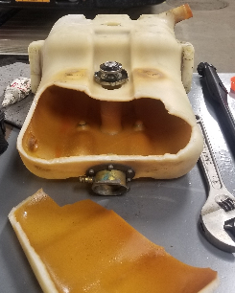
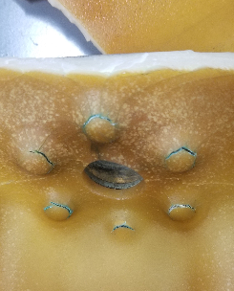
FIGURE #1
FIGURE #2
SHOULD THE RESERVOIR BE FOUND DEFECTIVE AND REQUIRE REPLACEMENT PLEASE CONTACT GTECH PARTS WITH THE BODY NUMBER OF THE UNIT TO ENSURE IT IS REPLACED WITH THE PROPER RESERVOIR.

Slide 3
CONTACT OUR SERVICE OR PARTS DEPARTMENT WITH ANY QUESTIONS
SERVICE
Director of Service
Ryan Hemund
rhemund@newyorkbussales.com
CELL 315-561-9121
Chittenango: 800-962-5768
Daryl Wallace
dwallace@newyorkbussales.com
Brian Lamaitis
blamaitis@newyorkbussales.com
Bob Reith
breith@newyorkbussales.com
Phil Tucker
ptucker@newyorkbussales.com
Albany: 866-867-1100
Ben Reiling
breiling@newyorkbussales.com
Rochester: 800-463-3232
Brandon Shepard
bshepard@newyorkbussales.com
Middletown: 845-609-7070
Moncia Mc Donald
mmcdonald@newyorkbussales.com
PARTS
Director of Parts
Matt ”Woody” Woodman
mwoodman@newyorkbussales.com
CELL 315-271-9748
Chittenango: 800-962-5768
Gari McQuade
gmcquade@newyorkbussales.com
Ted Nerveldine
tneveldine@newyorkbussales.com
John Lewin
jlewin@newyorkbussales.com
Garry Maniacek
gmaniacek@newyorkbussales.com
Jim Mattner
jmattner@#newyorkbussales.com
Albany/Middletown: 866-867-1100
Sean Conway
sconway@newyorkbussales.com
Dan Haight
dhaight@newyorkbussales.com
Rochester: 800-463-3232
James Roeser
jroeser@newyorkbussales.com
Tesea Cornwall
tcornwall@newyorkbussales.com
Comments or Concerns:
John Johnston
jjohnston@newyorkbussales.com
Cell 315-263-0766
Notes:
Set up as a table would make it easier to edit
Add additional pages

