Slide 1
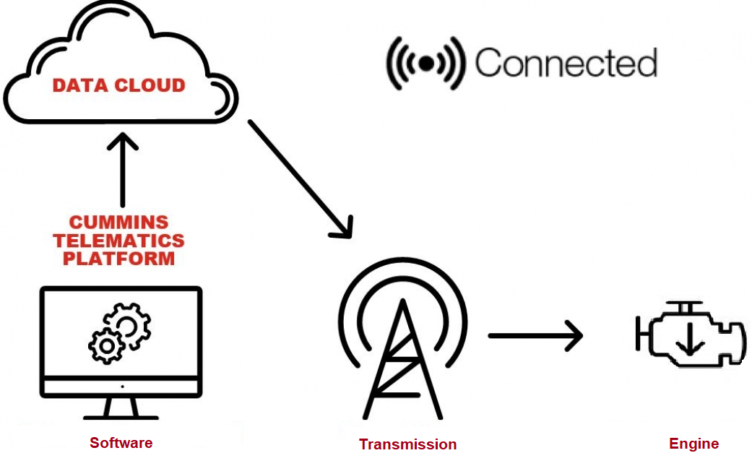
Service Update #23-0131
CUMMINS CONNECTIVITY MODULE
ADDED ELECTRONIC ENGINE MODULE
We have seen an electronic module mounted on the top of the engine (FIGURES #1 & #2) on recently delivered units.
We have learned that it is a “Connectivity Module” and is a Cummins® Inc. device that enables engines to have features like; system data logging, Connected Diagnostics, Connected Advisor, Connected Software Updates, ADEPT, etc. The Connectivity Module uses the vehicle J1939 network and the engine ECM to collect specific data to enable these features. It is located either on the engine or in the vehicle cabin.
FIGURE #3 shows an exploded view of the engine and location #4 is the Connectivity Module.

Slide 2
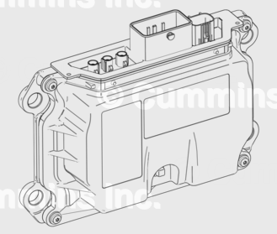
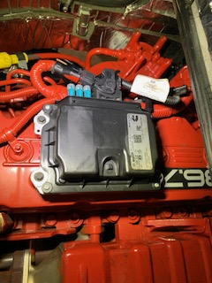
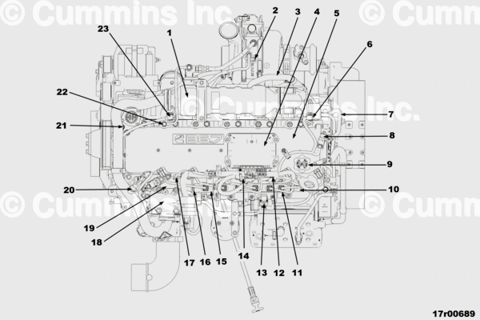
FIGURE #1
FIGURE #2
FIGURE #3

Slide 3
CONTACT ANY OF OUR SERVICE LOCATIONS WITH QUESTIONS
Director of Service
Ryan Hemund
rhemund@newyorkbussales.com
Chittenango: 800-962-5768
Daryl Wallace
dwallace@newyorkbussales.com
Brian Lamaitis
blamaitis@newyorkbussales.com
Bob Reith
breith@newyorkbussales.com
Phil Tucker
ptucker@newyorkbussales.com
Albany: 866-867-1100
Ben Reiling
breiling@newyorkbussales.com
Rochester: 800-463-3232
Brandon Shepard
bshepard@newyorkbussales.com
Middletown: 845-609-7070
Moncia Mc Donald
mmcdonald@newyorkbussales.com
Comments or Concerns:
John Johnston
jjohnston@newyorkbussales.com
Cell 315-263-0766
Notes:
Set up as a table would make it easier to edit
Add additional pages

