Slide 1
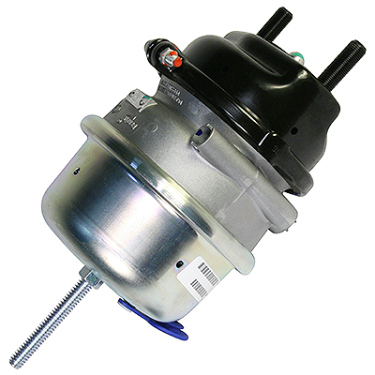
Parts Update #23-0424
Bendix Air Disc Rear Brake Chamber
Specifications on Blue Bird Units
When Replacing Rear Chambers, They MUST Be The Same Specification As The Unit Was Built With
Recently we have been told that certain suppliers are recommending that operators replace the 16/24 rear brake chambers with a 18/24 chamber on Blue Bird units equipped with the Bendix Air Disc brake system.
We have verified with Blue Bird that on their units they use the 16/24 chambers and will NOT certify units which have had a different model chamber installed.
We recommend anytime you are thinking of changing a part, even if believed to be an “upgrade”, with one which has a different specification that you verify through the manufacturer that the change has been certified…. AND you ask for documentation to be kept in the unit’s maintenance file.

Slide 2
CONTACT OUR SERVICE OR PARTS DEPARTMENT WITH ANY QUESTIONS
SERVICE
Director of Service
Ryan Hemund
rhemund@newyorkbussales.com
CELL 315-561-9121
Chittenango: 800-962-5768
Daryl Wallace
dwallace@newyorkbussales.com
Brian Lamaitis
blamaitis@newyorkbussales.com
Bob Reith
breith@newyorkbussales.com
Phil Tucker
ptucker@newyorkbussales.com
Albany: 866-867-1100
Ben Reiling
breiling@newyorkbussales.com
Batavia: 800-463-3232
Brandon Shepard
bshepard@newyorkbussales.com
Middletown: 845-609-7070
Moncia Mc Donald
mmcdonald@newyorkbussales.com
PARTS
Director of Parts
Matt Woodman
mwoodman@newyorkbussales.com
CELL 315-271-9748
Chittenango: 800-962-5768
Gari McQuade
gmcquade@newyorkbussales.com
Ted Nerveldine
tneveldine@newyorkbussales.com
John Lewin
jlewin@newyorkbussales.com
Garry Maniacek
gmaniacek@newyorkbussales.com
Jim Mattner
jmattner@#newyorkbussales.com
Albany/Middletown: 866-867-1100
Sean Conway
sconway@newyorkbussales.com
Dan Haight
dhaight@newyorkbussales.com
Batavia: 800-463-3232
James Roeser
jroeser@newyorkbussales.com
Tesea Cornwall
tcornwall@newyorkbussales.com

