Slide 1


Service Update #22-1207
EV Chargers Provided With Demo Units
We provide the charger while you demo the bus!
The School Bus EV Charge is on……with New York Bus Sales and Blue Bird leading the way!! We currently have several demos being shown and test driven throughout New York with informational events being offered for those interested in starting their EV journey or simply wanting to gain knowledge on what is available.
Whereas EV charging stations are popping up all over, there are some locations where they may not be located nor assessable to a school bus, so we are providing chargers and adapters for customers to charge while at their locations!
Generally, these chargers are required to be on a circuit rated at 40 AMPS minimum and in most repair facilities there is a welder plug which is in a circuit greater than 40 AMPS. We have found that that there are several NEMA (National Electrical Manufactures Association) plug configurations used within shops for welding where chargers would be plugged in, and we have worked to assemble an assortment of adapters for these along with added extension cable.
The NEMA plug configuration on the charger is a 6-50R and FIGURE #1 shows the configuration.

Slide 2
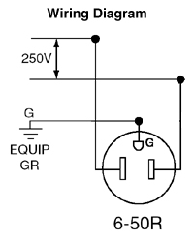
Figures #2-#7 shows the various adapters provided and Figure #8 shows the 10’ extension cable provided.
We have designed a stand for the charger (FIGURE #9) so that it is not left to try and hang or to lay on the floor. It is designed to come apart (FIGURE #10) and we have fit the charger, stand and adapters into a tote (FIGURE #12) to be delivered with demos when left at a customer’s location.
The only thing we ask is that the cords are neatly rolled up and the charger is wrapped in bubble wrap provided (FIGURE #13) when done and sent back with the demo unit.
We also have included a copy of Blue Bird Service Memorandum #SM22003 “EV Recommended Starting Procedure” and the Power Charge Manual.
As a reference should a location have another plug configuration, there is a sheet attached with the various NEMA welder plug configurations.
FIGURE #1

Slide 3
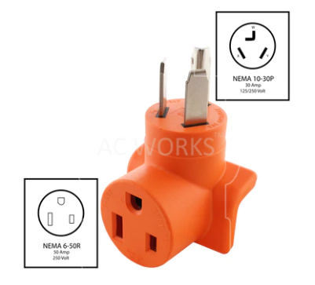
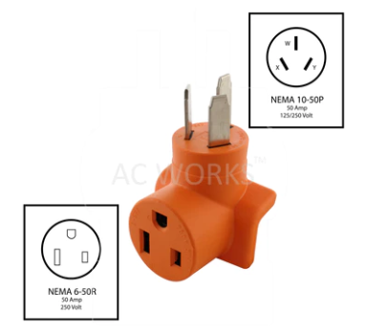
FIGURE #2
FIGURE #3

Slide 4
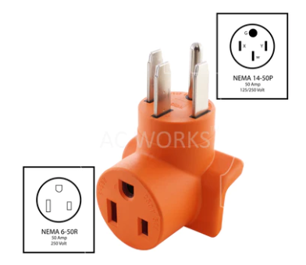
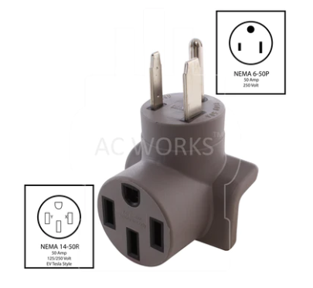
FIGURE #4
FIGURE #5

Slide 5
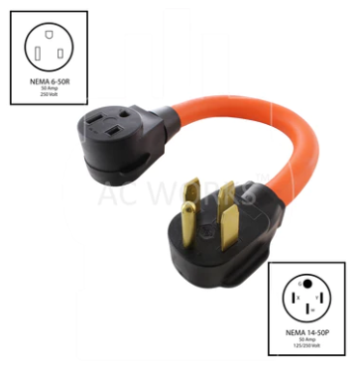
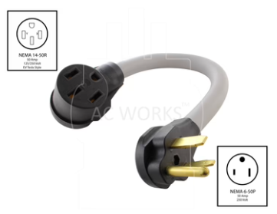
FIGURE #6
FIGURE #7

Slide 6
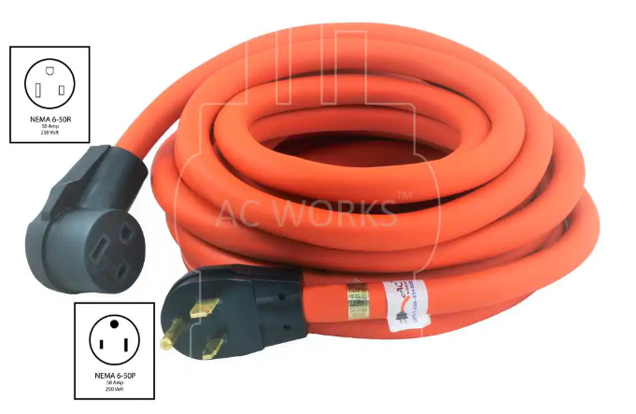
FIGURE #8

Slide 7
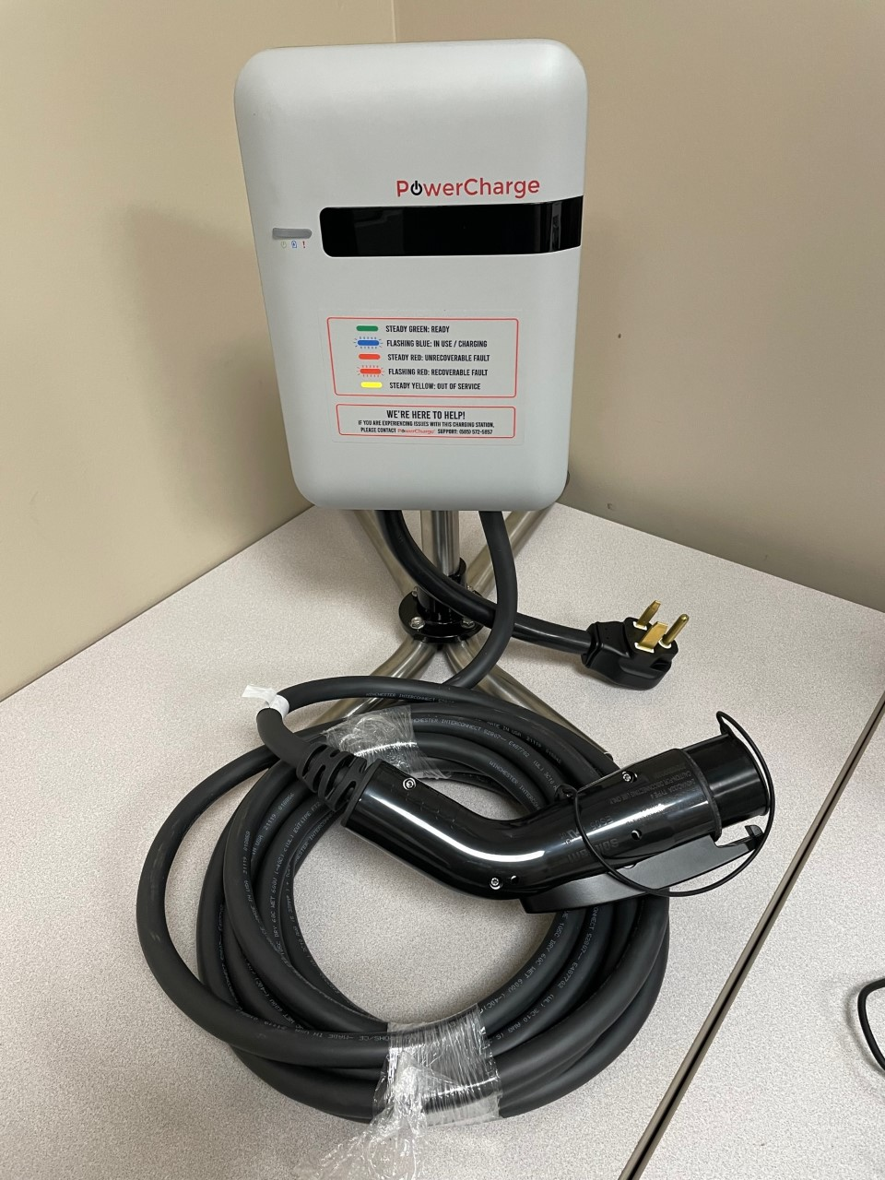
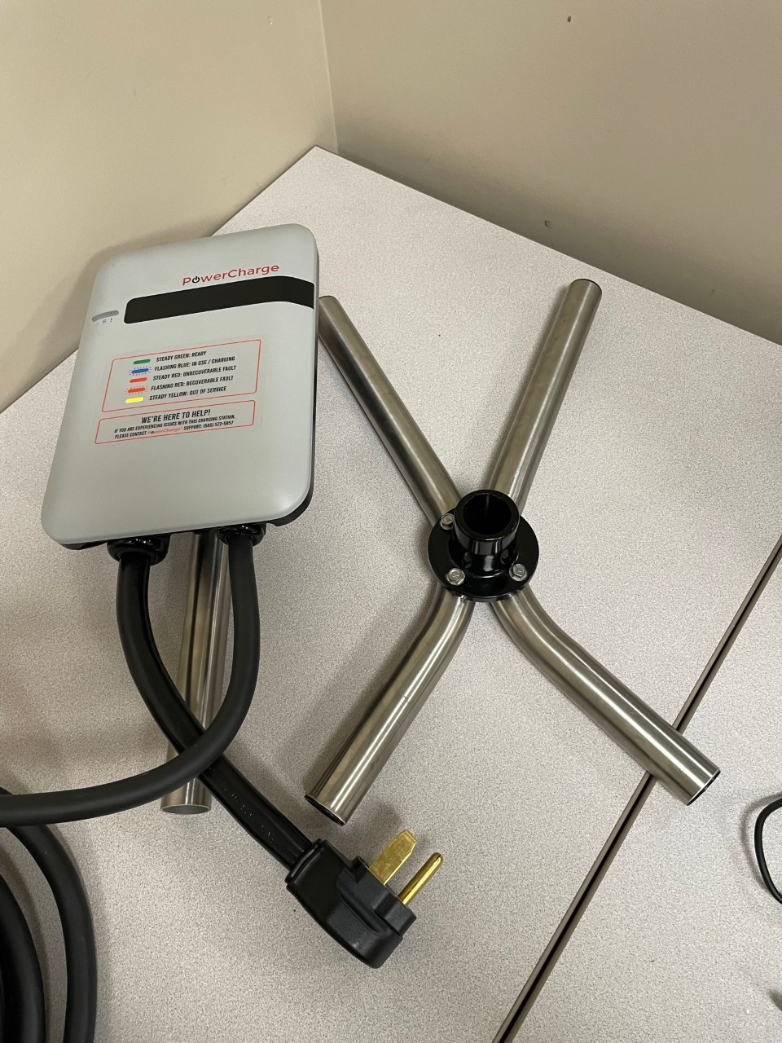
FIGURE #9
FIGURE #10

Slide 8
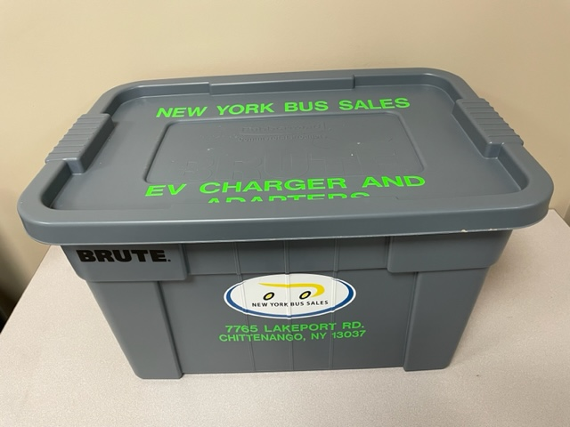
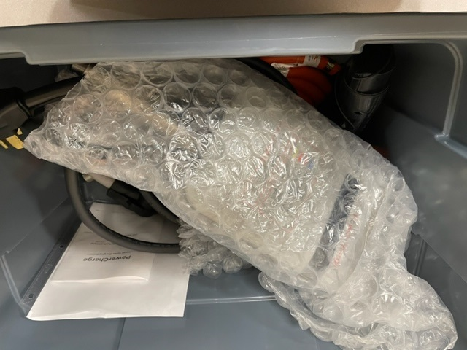
FIGURE #12
FIGURE #13

Slide 9
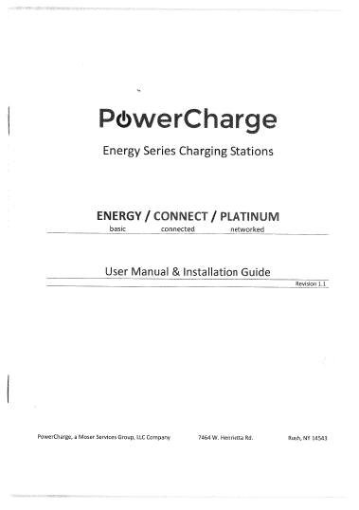

Slide 13
CONTACT ANY OF OUR SERVICE LOCATIONS OR YOUR SALES REPRESENTATIVE WITH QUESTIONS
Director of Service
Ryan Hemund
rhemund@newyorkbussales.com
Chittenango: 800-962-5768
Daryl Wallace
dwallace@newyorkbussales.com
Brian Lamaitis
blamaitis@newyorkbussales.com
Bob Reith
breith@newyorkbussales.com
Phil Tucker
ptucker@newyorkbussales.com
Albany: 866-867-1100
Ben Reiling
breiling@newyorkbussales.com
Rochester: 800-463-3232
Brandon Shepard
bshepard@newyorkbussales.com
Middletown: 845-609-7070
Moncia Mc Donald
mmcdonald@newyorkbussales.com
Director of Sales
Jeremy Johnston
jjohnston@newyorkbussales.com
315-706-8944
Josh Coon - Central
jcoon@newyorkbussales.com
Cell 315-264-1245
Kevin Coon - North
kcoon@newyorkbussales.com
Cell 315-415-6570
Peggy Allis - West
pallis@newyorkbussales.com
Cell 716-807-9264
Bill Lyons II - East
wlyons2@newyorkbussales.com
Cell 518-275-2816
Bruce Ferre – Rochester/Southern
bferre@newyorkbussales.com
Cell 585-645-3986
Comments or Concerns:
John Johnston
jjohnston@newyorkbussales.com
Cell 315-263-0766
Notes:
Set up as a table would make it easier to edit
Add additional pages

