Slide 1
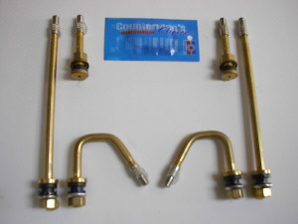
Service Update #23-0421
Tire Valve Stem Clearance with Air Disc Brakes
MAKE SURE TO CHECK VALVE STEM CLEARANCE WHEN CHANGING TIRES ON UNITS WITH AIR DISC BRAKES
Just recently, Horseheads Central School had a unit with Air Disc brakes which had an inner dual go flat.
Upon inspection, they found that the valve stem was positioned in such a way that the valve rubbed against a tab on the brake caliper (FIGURE #1) causing a hole in the stem of the valve.
Valve Stems come in a variety of sizes and shapes as shown above and if when mounting a new tire or changing a valve stem for any reason, care should be taken to replace with a “like” stem.
Once mounted, the tires should be rotated to ensure 1/2” of clearance between the valve stem and any obstructions such as the brake caliper.

Slide 2
FIGURE #1
PLEASE NOTE:
It is believed that there should have been a “clicking” noise heard when rotating the tire. But due in this case to a brass stem being used, the brass is so soft that there was no noise produced.
Please also alert tire dealers to the possibility of this issue!

Slide 3
CONTACT ANY OF OUR SERVICE LOCATIONS WITH QUESTIONS
Director of Service
Ryan Hemund
rhemund@newyorkbussales.com
Chittenango: 800-962-5768
Daryl Wallace
dwallace@newyorkbussales.com
Brian Lamaitis
blamaitis@newyorkbussales.com
Bob Reith
breith@newyorkbussales.com
Phil Tucker
ptucker@newyorkbussales.com
Albany: 866-867-1100
Ben Reiling
breiling@newyorkbussales.com
Rochester: 800-463-3232
Brandon Shepard
bshepard@newyorkbussales.com
Middletown: 845-609-7070
Moncia Mc Donald
mmcdonald@newyorkbussales.com
Comments or Concerns:
John Johnston
jjohnston@newyorkbussales.com
Cell 315-263-0766
Notes:
Set up as a table would make it easier to edit
Add additional pages

