Slide 1

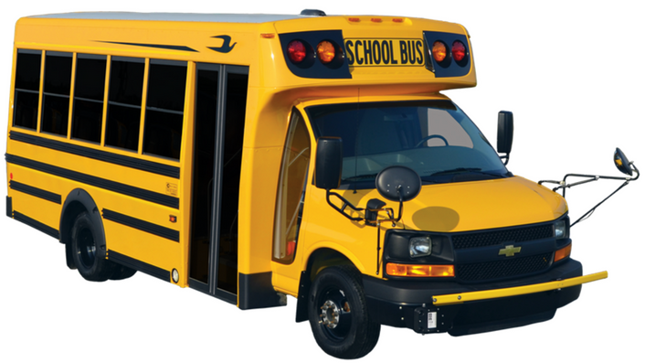
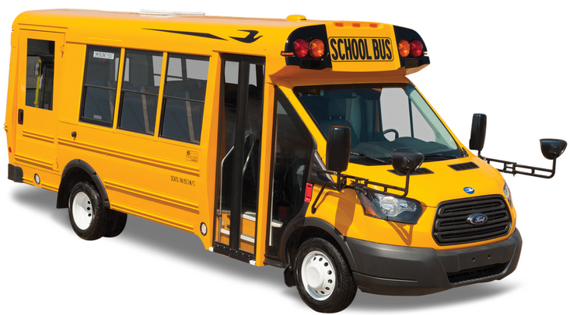
Service Update #23-0609
Micro Bird Body Maintenance & Warranty
Body Under Coat Maintenance/Photo Requirements for Warranty
Recently when submitting warranty for body panel replacement on the Micro Bird product we have been asked to get additional photos from the inner side of body skins which have corroded and require replacement along with photos of the backside of the body skins in question. Per Micro Bird ““For the side skins, before any repairs are done, we require pictures from the inner side of both skins to evaluate exact location with surrounding components and state of the internal side of side skins, both sides where perforation is occurring. Send picture from the best angles you can get and make sure they are not blurry with enough lighting.”
Therefore, when an issue is identified with a side panel and we are contacted for a warranty repair, we will be asking for the unit to be lifted so that we can get the necessary photos for pre-authorization.
As part of their maintenance requirements for warranty, Micro Bird requires periodic (Quarterly) inspection of undercoating to maintain sufficient coverage and protection of the underside of the body. Attached is a “Tip” from Micro Bird with an excerpt from their Service Manual.

Slide 3
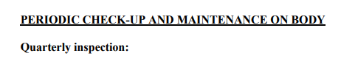
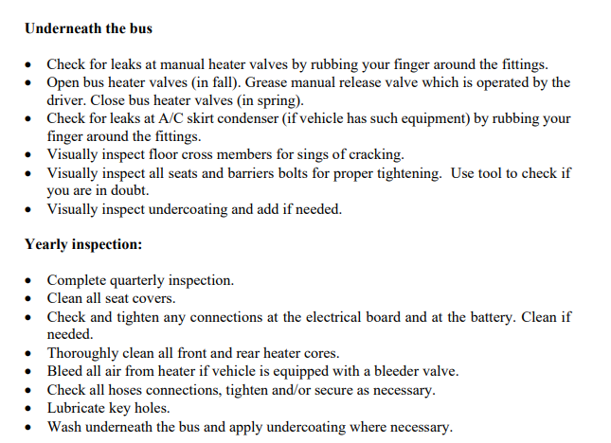

Slide 4

CONTACT ANY OF OUR SERVICE LOCATIONS WITH QUESTIONS
Director of Service
Ryan Hemund
rhemund@newyorkbussales.com
Chittenango: 800-962-5768
Brian Lamaitis
blamaitis@newyorkbussales.com
Bob Reith
breith@newyorkbussales.com
Phil Tucker
ptucker@newyorkbussales.com
Albany: 866-867-1100
Ben Reiling
breiling@newyorkbussales.com
Batavia: 800-463-3232
Brandon Shepard
bshepard@newyorkbussales.com
Middletown: 845-609-7070
Moncia Mc Donald
mmcdonald@newyorkbussales.com
Notes:
Set up as a table would make it easier to edit
Add additional pages

