Slide 1
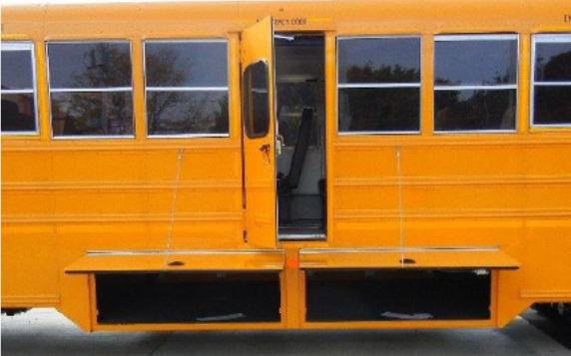
Service Update #23-0719
Side Emergency Door – Luggage Obstruction
Open Luggage Obstructs Operation of Side Emergency Door
We had recognized an issue mainly with some installations of our fiberglass luggage boxes when they were mounted under the side emergency doors. With this configuration, when the luggage box door was open, it obstructed the operation of the side emergency door from opening fully.
We started with first a mechanical device (Tech Tip #15-1001) and then a cable (Tech Tip #15-1001REVB) to hold the luggage box doors at 90* and not allow contact with the side emergency door when being opened.
In May of 2021 we released an update where we had sourced a strut which could replace the existing strut and it was short enough to hold the door at 90* and therefore required no modifications.

Slide 2
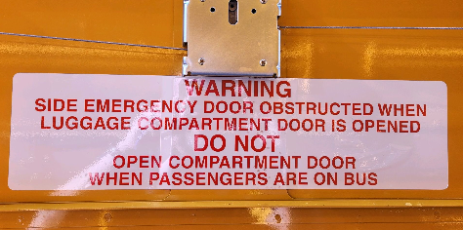
Recently we have seen an increase in factory mounted steel luggage and again with these mounted under the side emergency door we have seen the side emergency door obstructed and not fully open.
Blue Bird addresses this issue by using a decal as shown in Figure #1 stating that the luggage should not be opened if passengers are present on the bus.
New York Bus Sales realizes this is one way to address, but has strived to resolve the issue from occurring. We had tried using the strut which was used on the fiberglass luggage (#4683) but found it was too long and still allowed the door to open past 90*.
We have spec’d a shorter version which does work and keeps the steel luggage door from opening too far (#4041) as seen in Figure #2. Both are available through our Parts Department.
Figure #1
Figure #2
#4683 – Used on Fiberglass Luggage List Price $24.13
#4041 – Used on Steel Luggage List Price $15.64

Slide 3
CONTACT ANY OF OUR SERVICE LOCATIONS WITH QUESTIONS
Director of Service
Ryan Hemund
rhemund@newyorkbussales.com
Chittenango: 800-962-5768
Brian Lamaitis
blamaitis@newyorkbussales.com
Bob Reith
breith@newyorkbussales.com
Phil Tucker
ptucker@newyorkbussales.com
Albany: 866-867-1100
Ben Reiling
breiling@newyorkbussales.com
Batavia: 800-463-3232
Brandon Shepard
bshepard@newyorkbussales.com
Middletown: 845-609-7070
Moncia Mc Donald
mmcdonald@newyorkbussales.com
Comments or Concerns:
John Johnston
jjohnston@newyorkbussales.com
Cell 315-263-0766
Notes:
Set up as a table would make it easier to edit
Add additional pages

