Slide 1
Service Update #23-0531
Valeo A/C Front A/C Power Board Stud
Power Stud May Not Have Been Properly Torqued
Trans/South who installs Air Conditioning systems on Type C & D Blue Bird products has identified an issue which could affect the operation of the front system on units with a split system.
What has been found is that the stud where the cable mounts feeding power to the front system circuit board may not have been properly torqued. This has been found to cause high resistance, heating the stud and causing the circuit board to fail.
We are asking that you follow the following steps to ensure the stud is properly torqued:

Slide 2
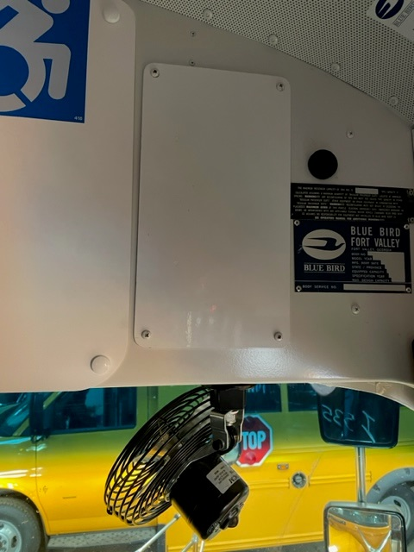
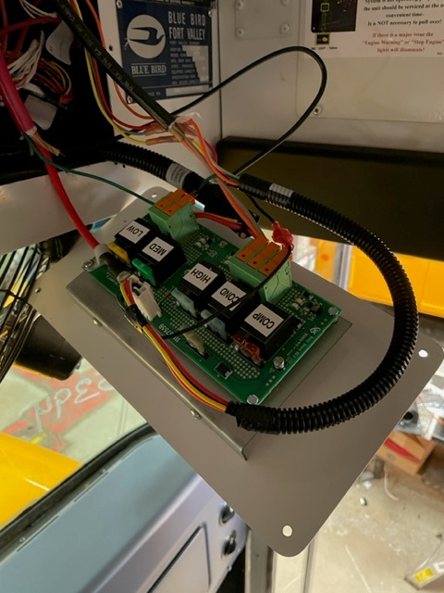
In the right front bulkhead above the stepwell, you will find a rectangular panel mounted as shown in FIGURE #1.
Remove 4 screws and carefully remove panel where you will find the A/C circuit board mounted to the inside of the panel shown in FIGURE #2.
At the lower corner of the circuit board, you will find a red cable passing through a “P” clip which is attached to the corner mounting screw for the circuit board and has a ring terminal crimped on the end which mounts to the circuit board as shown in FIGURE #3.
Inspect heat shrink around ring terminal and confirm there is no damage, if damage is found, replace heat shrink, inspect circuit board for any issues cause by heat, please take photos of any damage and contact New York Bus Sales Warranty Department and a new circuit board will be provided. Using an 8MM socket and inch/lb. torque wrench, torque to 18 in./lb.
Once complete, reassemble
FIGURE #1
FIGURE #2

Slide 3
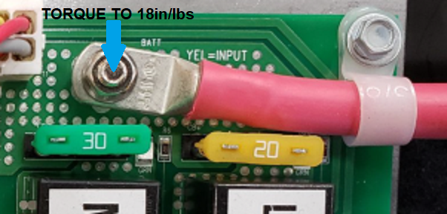

Slide 4
CONTACT ANY OF OUR SERVICE LOCATIONS WITH QUESTIONS
Director of Service
Ryan Hemund
rhemund@newyorkbussales.com
Chittenango: 800-962-5768
Brian Lamaitis
blamaitis@newyorkbussales.com
Bob Reith
breith@newyorkbussales.com
Phil Tucker
ptucker@newyorkbussales.com
Albany: 866-867-1100
Ben Reiling
breiling@newyorkbussales.com
Batavia: 800-463-3232
Brandon Shepard
bshepard@newyorkbussales.com
Middletown: 845-609-7070
Moncia Mc Donald
mmcdonald@newyorkbussales.com
Comments or Concerns:
John Johnston
jjohnston@newyorkbussales.com
Cell 315-263-0766
Notes:
Set up as a table would make it easier to edit
Add additional pages

