Slide 1
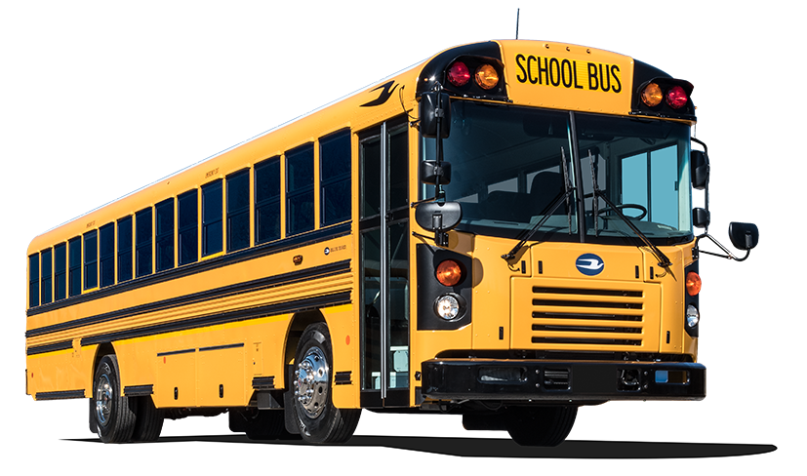
Service Update #23-0517
ALL AMERICAN FRONT ENGINE-T3FE FUEL LINE ROUTING
FUEL LINE MAY BE RUBBING ON UNDERSIDE OF ENGINE OPENING
We were just made aware of an issue with fuel line routing to the engine at the driver side rear of the engine bay being in a position where the possibility of the lines rubbing on the lower lip of the engine bay access to a point where possible damage to the hose could occur. (FIGURE #1).
We contacted Blue Bird and learned that the bracket for routing the hoses has the plastic holder for securing the lines bolted incorrectly to the bracket positioning the lines above the bracket and when properly positioned below the bracket provides sufficient clearance. (FIGURES #2 & #3)

Slide 2
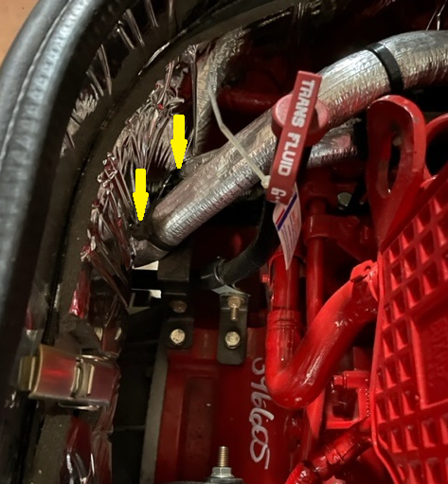
FIGURE #1

Slide 3
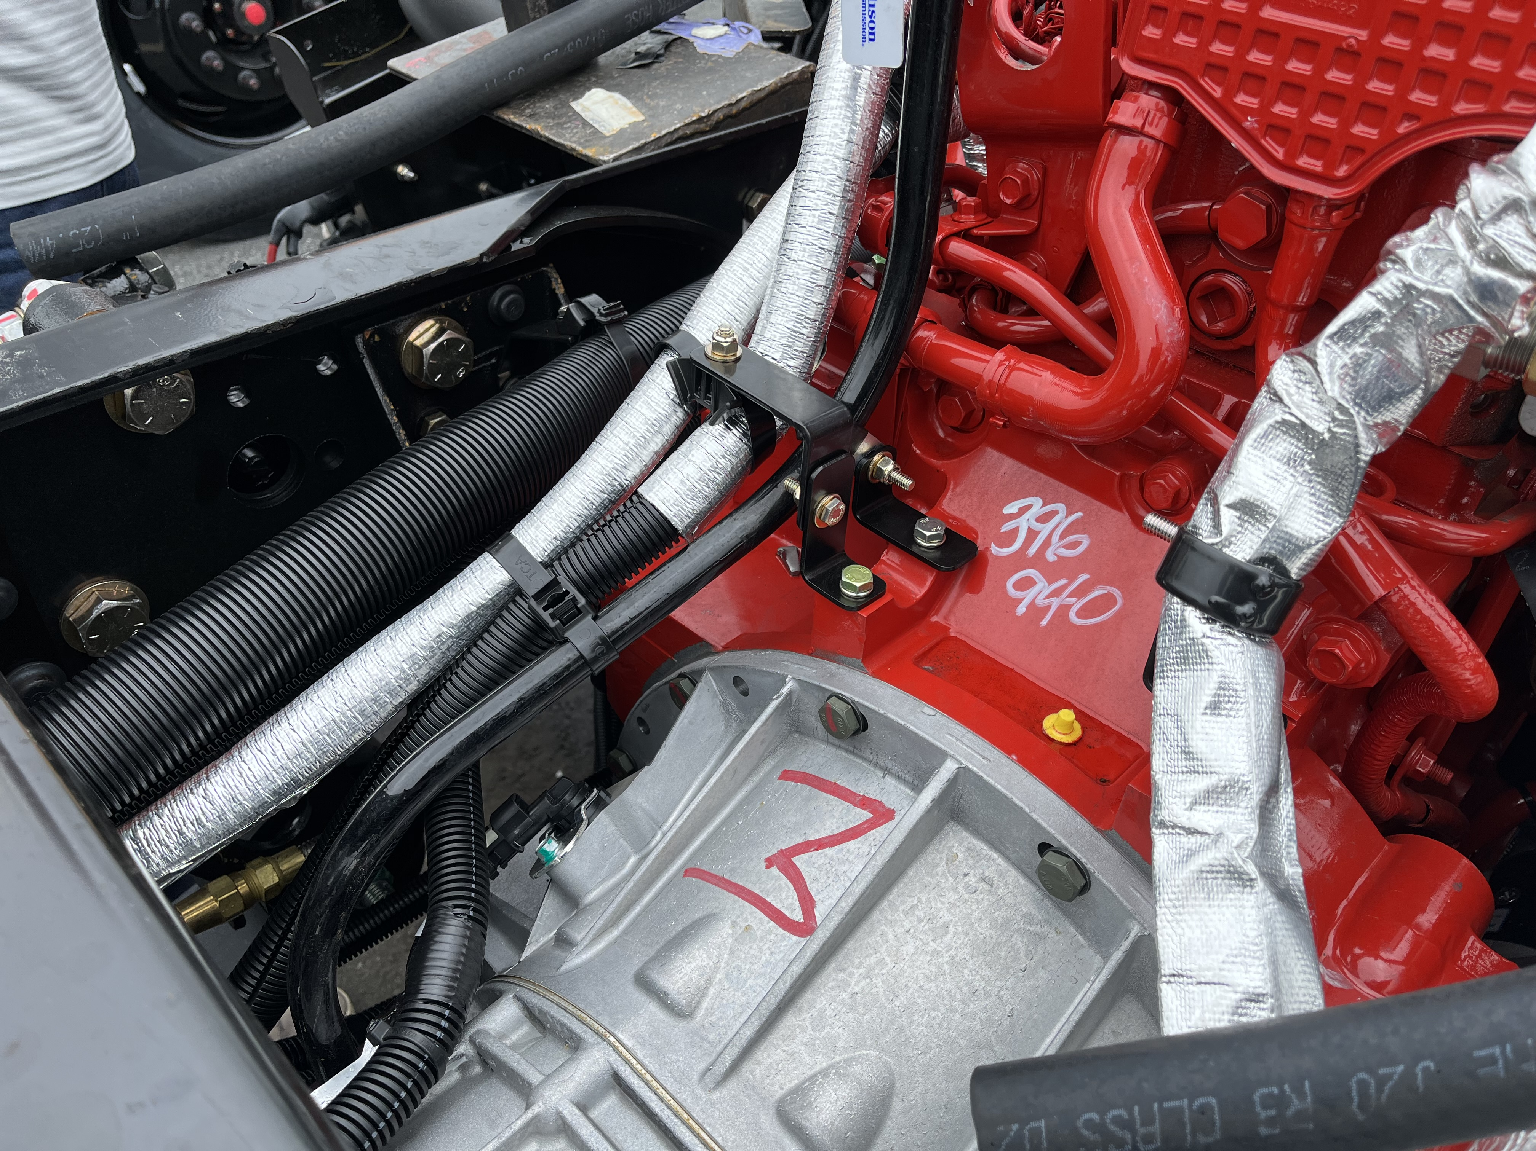
FIGURE #1
FIGURE #2
PLEASE NOTE:
Part number for the plastic holder for the lines is:
#00024043

Slide 4
CONTACT ANY OF OUR SERVICE LOCATIONS WITH QUESTIONS
Director of Service
Ryan Hemund
rhemund@newyorkbussales.com
Chittenango: 800-962-5768
Daryl Wallace
dwallace@newyorkbussales.com
Brian Lamaitis
blamaitis@newyorkbussales.com
Bob Reith
breith@newyorkbussales.com
Phil Tucker
ptucker@newyorkbussales.com
Albany: 866-867-1100
Ben Reiling
breiling@newyorkbussales.com
Rochester: 800-463-3232
Brandon Shepard
bshepard@newyorkbussales.com
Middletown: 845-609-7070
Moncia Mc Donald
mmcdonald@newyorkbussales.com
Comments or Concerns:
John Johnston
jjohnston@newyorkbussales.com
Cell 315-263-0766
Notes:
Set up as a table would make it easier to edit
Add additional pages

