Slide 1
Service Update #23-0726
BLUE BIRD EV VISION BUS DECALS
Blue Bird EV Unit Identification
With the increased presence of the Blue Bird EV product in service and the fact that the units’ appearance do not clearly identify them as being an EV, we have come up with the decal which will be located at several points along with other important location identification points on our EV units as described here.
Required Decals:
1 - #453 WAIT TO START
1 - #454 WAIT TO START - DIRECTIONS
2 - #461 ELECTRIC POWERED-LARGE
3 - #460 ELECTRIC POWERED-SMALL
1 - #455 12 VOLT BATTERY AND DISCONNECT SWITCH INSIDE
4 - #458 HIGH VOLTAGE BATTERY
4 - #34 BLACK ARROW
2 - #462 HIGH VOLTAGE BATTERY DISCONNECT w/ARROWS
- #463 EV DIAG PORT
- #464 CHARGING PORT
1 - #465 EV CLUSTER WARNING

Slide 2
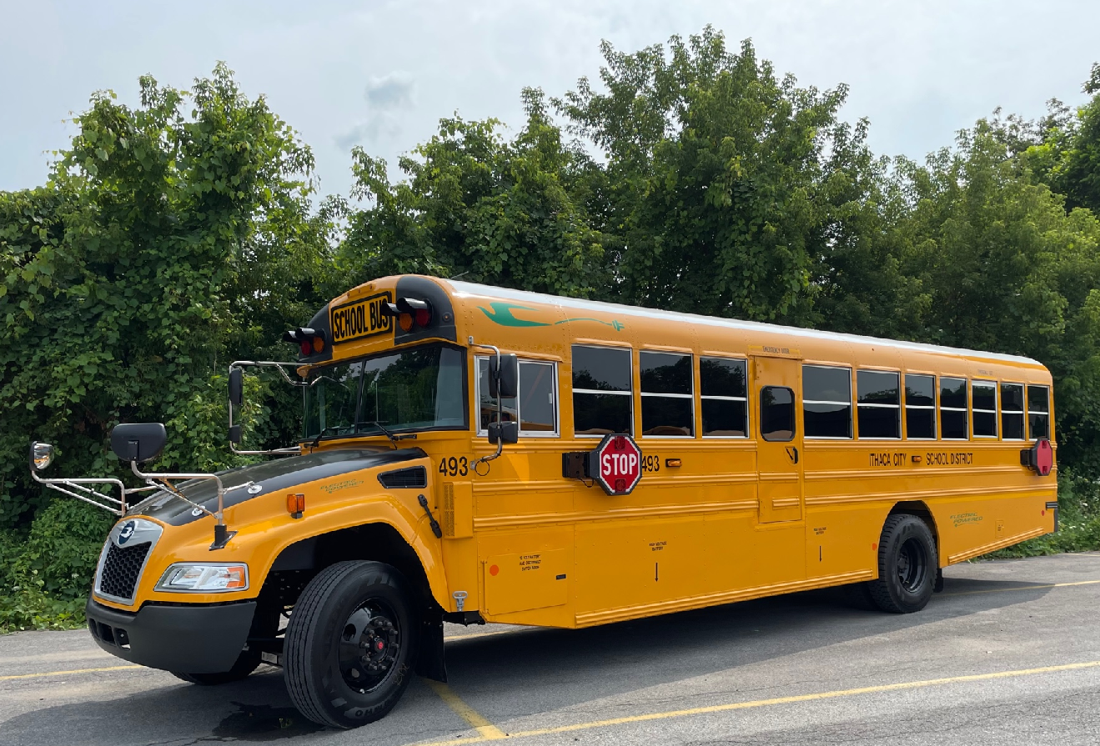
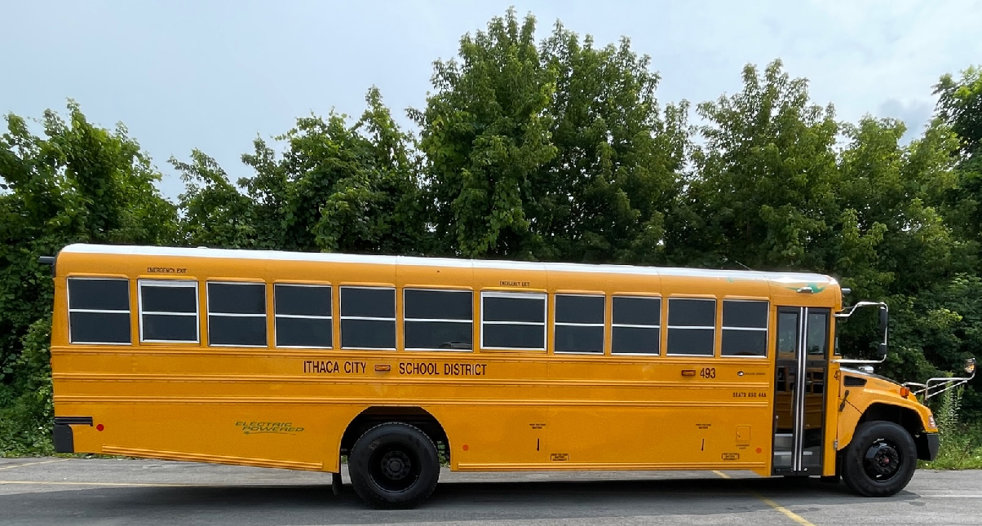

Slide 3
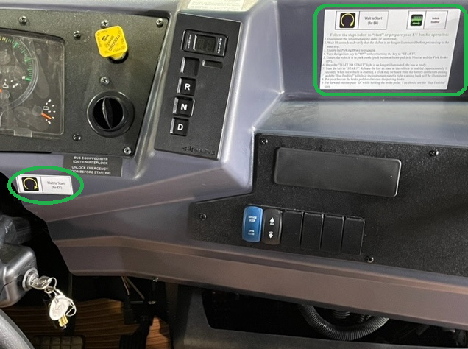
In the driver’s area we have #453 & #454 concerning the starting procedure as outlined in our Service Update #22-1129 – See Figure #1
Figure #1
2 Large “ELECTRIC POWERED” decals #461 are on the rear overhang behind the rear duals. Should be 1” below rivet line at floor level and placed so lettering starts at 3rd rivet from wheel well opening. Figures #2 & #3
Figure #2
Figure #3

Slide 4
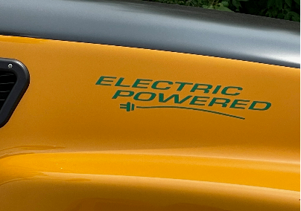
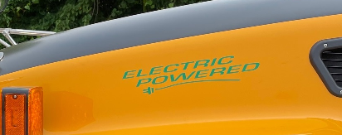
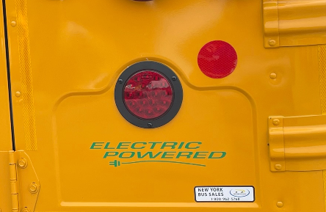
3 Small “ELECTRIC POWERED” decals #460…. 2 are on each side of the hood centered between the lollipop light and vent. Figures #4 & #5 1 placed in license plate indent of right rear tag panel. Figure #6
Figure #4
Figure #5
Figure #6

Slide 5
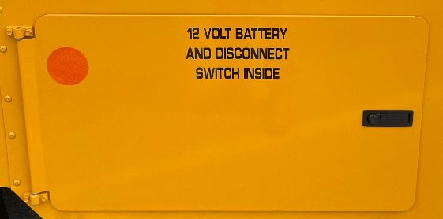
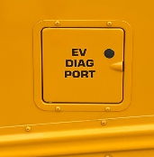
#455, 12 VOLT BATTERY AND DISCONNECT SWITCH INSIDE is to be placed on battery box door, 1” from upper edge and centered vertically. Figure #7
Figure #7
Access door in the left rear overhang is there to provide access to a diagnostic port for the high voltage system. This is labeled with #463. Figure #8
Figure #8
Depending on the option ordered, the charging port can be located just behind the entrance door or in the rear overhang. No matter which location, the access will be labeled with #464 CHARGING PORT Figure #9
Figure #9

Slide 6
HIGH VOLTAGE BATTERY #458 are to be put on both sides of unit 1” below the rivet line at floor level in the center of each battery pack with black arrows, #34 pointed down halfway between the decal and the bottom of the skirt. (Figures #10 & #11)
Figure #10
HIGH VOLTAGE BATTERY DISCONNECT w/ARROWS #462 are to be put on right side of unit exactly where disconnects are located on the battery packs and are to be on the skirts just above the lower rub rail. (Figure #11)
Figure #11

Slide 7
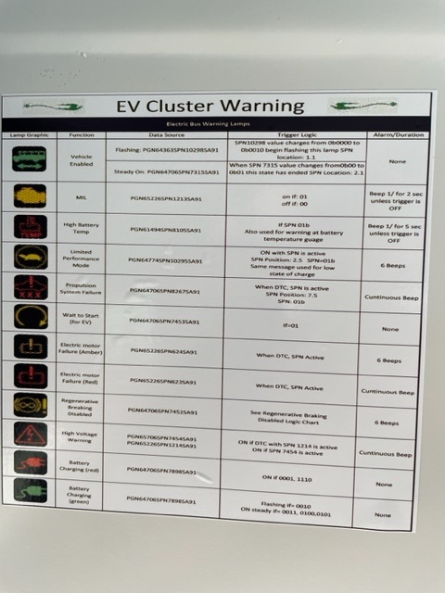
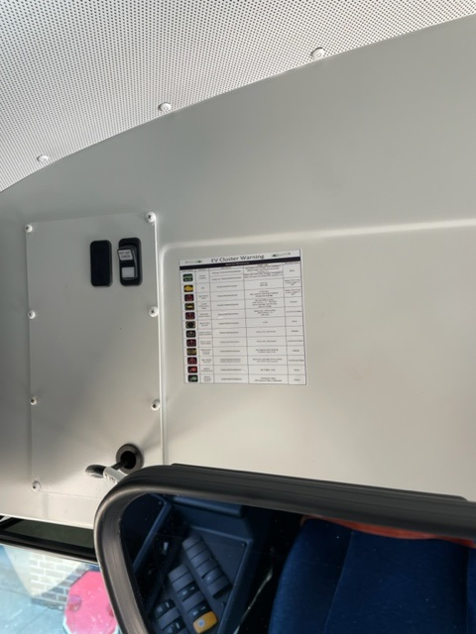
EV CLUSTER WARNING DECAL #465 – The decal displays dash cluster warning icons with the referenced function. Decal is to be located on the bulkhead above the driver. (Figures #12 & #13)
Figure #12
Figure #13

Slide 8
CONTACT ANY OF OUR SERVICE LOCATIONS WITH QUESTIONS
Director of Service
Ryan Hemund
rhemund@newyorkbussales.com
Chittenango: 800-962-5768
Brian Lamaitis
blamaitis@newyorkbussales.com
Bob Reith
breith@newyorkbussales.com
Phil Tucker
ptucker@newyorkbussales.com
Albany: 866-867-1100
Ben Reiling
breiling@newyorkbussales.com
Batavia: 800-463-3232
Brandon Shepard
bshepard@newyorkbussales.com
Middletown: 845-609-7070
Moncia Mc Donald
mmcdonald@newyorkbussales.com
Comments or Concerns:
John Johnston
jjohnston@newyorkbussales.com
Cell 315-263-0766
Notes:
Set up as a table would make it easier to edit
Add additional pages

