Slide 1
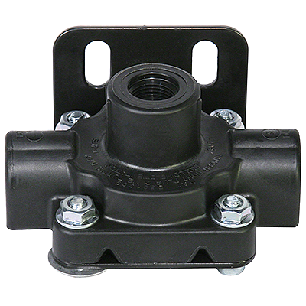
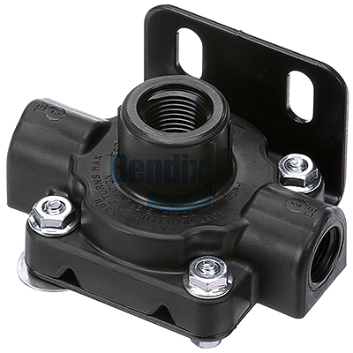
Parts/Service Update #23-0707
Quick Release Valve Update
#10053236
#10071317/#10026778
Changes in Valves for “Crack Pressure” to Extend Brake Life
Recently it was pointed out that the “Quick Release” valves for the rear brakes had changed. If you look closely at the at the valves there is a metal washer located under the head of one of the bolts which you can see if you look closely at the valves above.
This number indicates the crack pressure of the valve, QRO33 on the #10053236 indicates a 3.3PSI crack pressure and QRO 60 on the #10026778 indicates a 6.0PSI crack pressure.
Physically the valves appear the same accept that the threaded ports are not the same size, and after researching we found that the difference was in the “Crack Pressure”. The #10053236 has a 3PSI crack pressure with 3/8” NPT ports where the #10026778 which is currently used (it superseded #10071317) has a 4.5-7PSI crack pressure and a ½” NPT inlet and 3/8” NPT outlets.

Slide 2
Working with Blue Bird on why there was a change, we learned that with the launch of air disc brakes there was not a quick release valve used which required a specific crack pressure.
In 2016 due to accelerated drive axle brake wear they initiated a PHRED which lead to a project amending the drive axle brake “Bill Of Materials” to incorporate a 3PSI crack pressure quick release valve (#10053236).
Then in June of 2020 Blue Bird launched another PHRED for accelerated brake wear on rear drum brakes which lead to a project to add a 4.5-7PSI crack pressure quick release valve (#10071317) and at that time they were also seeing accelerated brake wear on air disc brakes, so they amended the drive axle brake “Bill Of Materials” for both air disc and drum to incorporate the 4.5-7PSI crack pressure quick release valve (#10071317).
Then the #10071317 was superseded to a #10026778.
We then asked the question as to if the newer #10026778 could be used in place of the #10053236 and told that it could, but as noted previously, the inlet threads are different which would require use of a bushing or different fitting.
PLEASE NOTE:
New York Bus Sales recommends only replacing parts with those that units were initially built with.

Slide 3
CONTACT OUR SERVICE OR PARTS DEPARTMENT WITH ANY QUESTIONS
SERVICE
Director of Service
Ryan Hemund
rhemund@newyorkbussales.com
CELL 315-561-9121
Chittenango: 800-962-5768
Brian Lamaitis
blamaitis@newyorkbussales.com
Bob Reith
breith@newyorkbussales.com
Phil Tucker
ptucker@newyorkbussales.com
Brian Goodfellow
bgoodfellow@newyorkbussales.com
Albany: 866-867-1100
Ben Reiling
breiling@newyorkbussales.com
Batavia: 800-463-3232
Brandon Shepard
bshepard@newyorkbussales.com
Middletown: 845-609-7070
Moncia Cherry
mcherry@newyorkbussales.com
PARTS
Director of Parts
Matt Woodman
mwoodman@newyorkbussales.com
CELL 315-271-9748
Chittenango: 800-962-5768
Gari McQuade
gmcquade@newyorkbussales.com
Ted Nerveldine
tneveldine@newyorkbussales.com
John Lewin
jlewin@newyorkbussales.com
Garry Maniacek
gmaniacek@newyorkbussales.com
Jim Mattner
jmattner@#newyorkbussales.com
Albany/Middletown: 866-867-1100
Sean Conway
sconway@newyorkbussales.com
Dan Haight
dhaight@newyorkbussales.com
Batavia: 800-463-3232
James Roeser
jroeser@newyorkbussales.com
Tesea Cornwall
tcornwall@newyorkbussales.com
Comments or Concerns:
John Johnston
jjohnston@newyorkbussales.com
Cell 315-263-0766
Notes:
Set up as a table would make it easier to edit
Add additional pages

