Slide 1
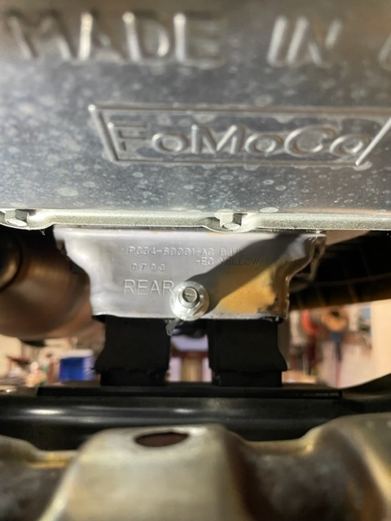
Service Update #23-1014
Blue Bird Vision/Ford Transmission Tail Shaft Mount Stamping
FIGURE #1
Transmission Tail Shaft Mount Stamped “REAR”
We have found that on units with the Ford 6R140 transmission, the rear tail shaft mount has been updated as pictured in FIGURES #1 & #3 and is stamped with the word “REAR” on one side.
The issue with this is that the side stamped is actually facing the FRONT on some units. We have contacted Blue Bird engineering concerning the correct orientation of the mount.

Slide 2
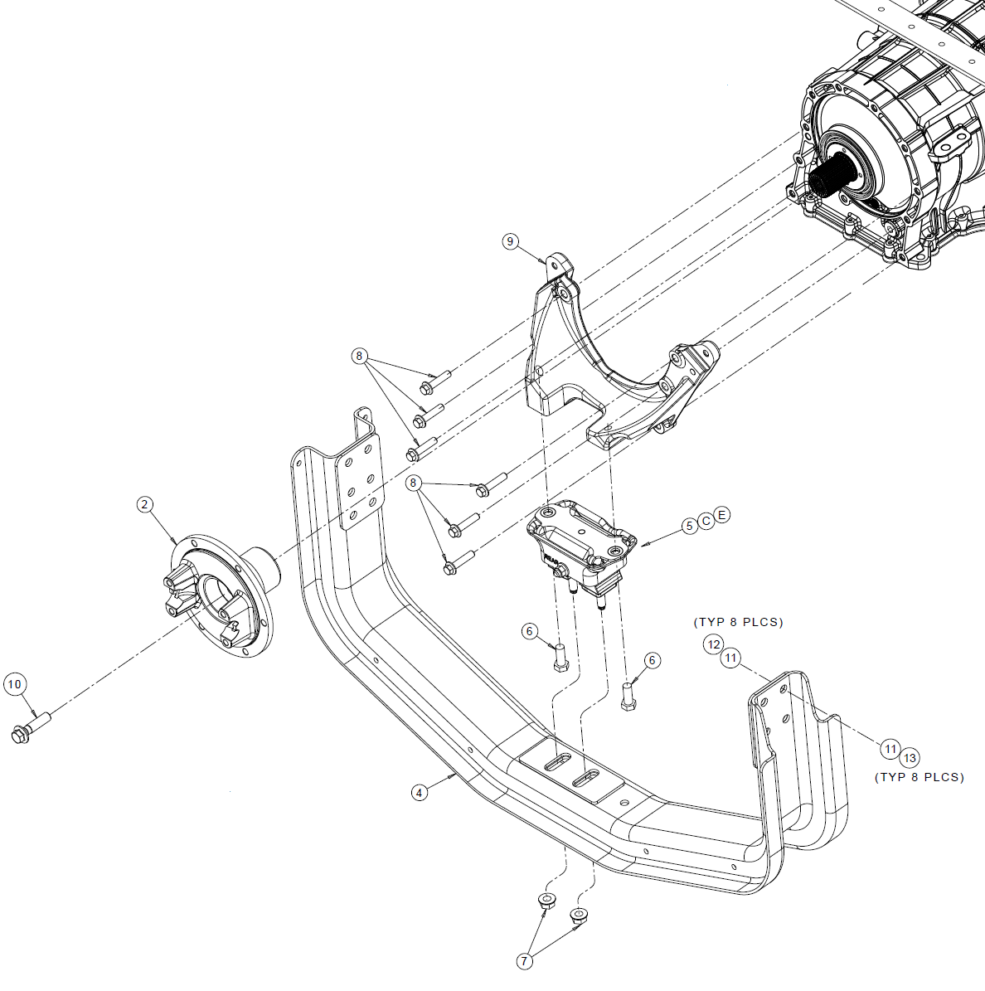
What was found is that the mount is used in several vehicle applications using the 6R140 transmission, and in some of those applications the mount needed to be oriented specifically to obtain required clearance.
This is NOT the case when used on the Blue Bird BBCV, so mounting from front to rear
is not specified and on the BBCV it can
be mounted either way.
FIGURE #2

Slide 3
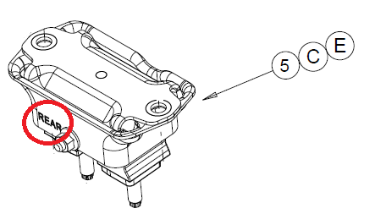
FIGURE #3

Slide 4
CONTACT OUR SERVICE OR PARTS DEPARTMENT WITH ANY QUESTIONS
Director of Service
Ryan Hemund
rhemund@newyorkbussales.com
Chittenango: 800-962-5768
Brian Lamaitis
blamaitis@newyorkbussales.com
Bob Reith
breith@newyorkbussales.com
Phil Tucker
ptucker@newyorkbussales.com
Albany: 866-867-1100
Ben Reiling
breiling@newyorkbussales.com
Batavia: 800-463-3232
Andrew Faskel
afaskel@newyorkbussales.com
Middletown: 845-609-7070
Moncia Cherry
mcherry@newyorkbussales.com
Comments or Concerns:
John Johnston
jjohnston@newyorkbussales.com
Cell 315-263-0766
Notes:
Set up as a table would make it easier to edit
Add additional pages

