Slide 1
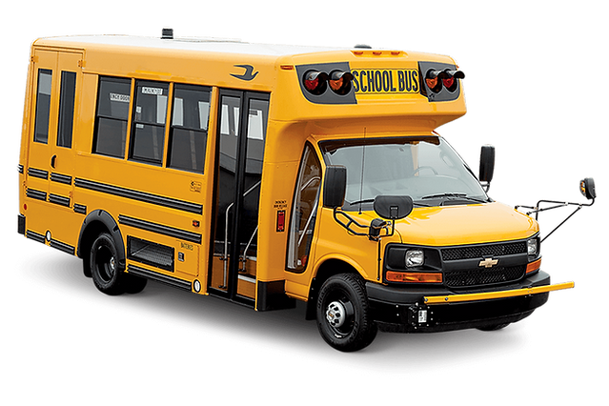


Service Update #23-1117
Fuel Line Heat Shield Required on Chevrolet/GM 6.6L Micro Bird
Required Fuel Line Heat Shield
It was brought to us that there are gas lines located on the driver (left) side toward the rear of the transmission where the exhaust from the left bank of the engine comes across and the distance between these lines and the exhaust is closer than the NYSDOT minimum requirement of 8” (FIGURE #1). These lines are just above the transmission crossmember and the exhaust crosses just in front of the crossmember (FIGURES #2 & #3)
On previously delivered units there was exhaust heat “wrap” which was applied to the exhaust in order to shield and in some cases the wrap has deteriorated or torn which required repair/replacement.
We have since designed a steel “shield” (Page #3) which we will be installing on units delivered and which we will be providing at no charge should customers choose to install.
PLEASE NOTE: Heat shields are currently being fabricated and once received we will be sending them directly to customers who have purchased units and ask that they be installed per the following instructions.

Slide 2
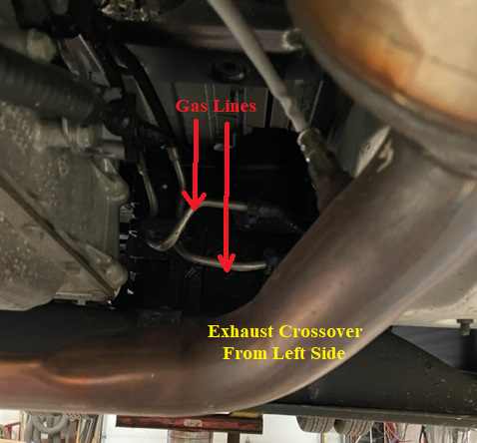
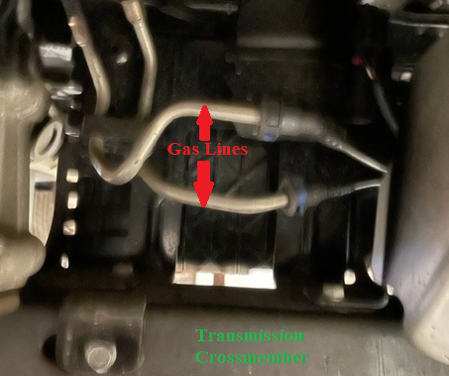
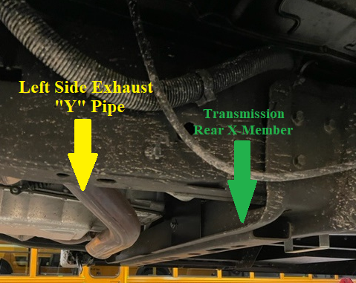
FIGURE #1
FIGURE #2
FIGURE #3

Slide 3
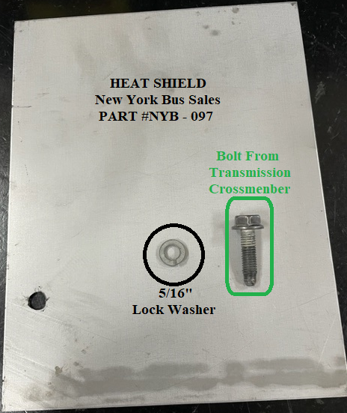
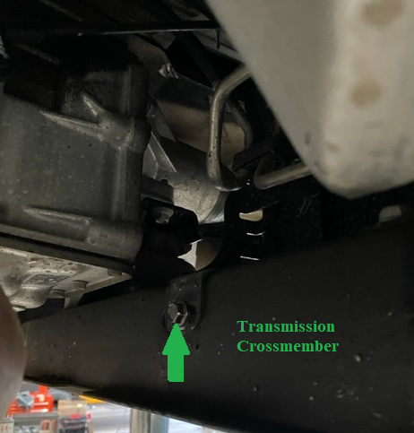
Fuel Line Heat Shield & Installation Instructions
PARTS REQUIRED
Heat Shield Part #NYB/0051
5/16” Lock Washer
Bolt From Chassis X-Member
Locate bolt in front of
transmission crossmember
as shown in photo

Slide 4
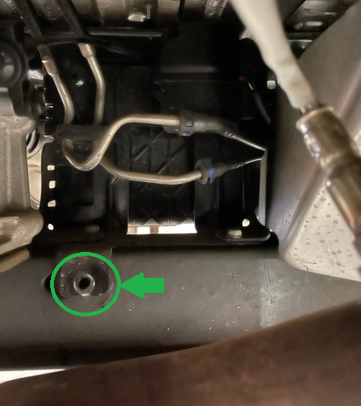
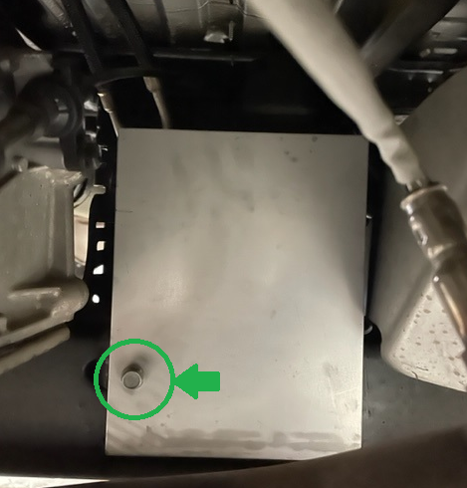
- Once bolt is removed, install and position heat shield to protect gas lines.
- Using bolt which was removed and adding the 5/16” lock washer tighten and torque to 8 ft./lbs.

Slide 5

CONTACT ANY OF OUR SERVICE LOCATIONS WITH QUESTIONS
Director of Service
Ryan Hemund
rhemund@newyorkbussales.com
Chittenango: 800-962-5768
Brian Lamaitis
blamaitis@newyorkbussales.com
Bob Reith
breith@newyorkbussales.com
Phil Tucker
ptucker@newyorkbussales.com
Albany: 866-867-1100
Ben Reiling
breiling@newyorkbussales.com
Batavia: 800-463-3232
Andrew Faskel
afaskel@newyorkbussales.com
Middletown: 845-609-7070
Moncia Cherry
mcherry@newyorkbussales.com
Comments or Concerns:
John Johnston
jjohnston@newyorkbussales.com
Cell 315-263-0766
Notes:
Set up as a table would make it easier to edit
Add additional pages

